Slide 1
Permutation & Combination

Slide 2
Permutation
per·mu·ta·tion
A way, esp. one of several possible variations, in which
a set or number of things can be ordered or arranged.
Definition:
A permutation is an arrangement in a definite order of a number of objects taken some or all at a time.
Note:
Whenever we deal with permutations order is important.

Slide 3

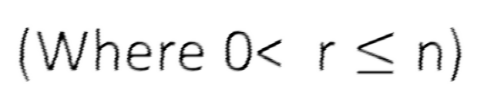
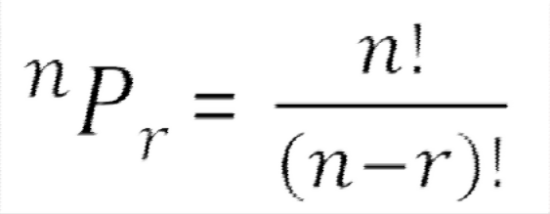
Theorem 1
Number of permutations of n different objects taken r at a time is:

Slide 4




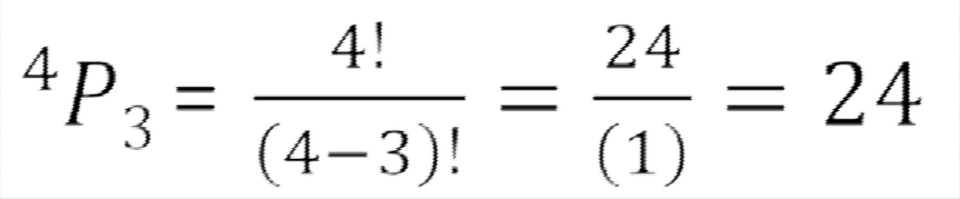
Example
How many different signals can be made by 3 flags from 4-flags of different colors?
Here n= 4 and r =3 as we need to make a combination of 3 flags out of 4 flags. Therefore…

Slide 5
Analytically…
1
= 4 ways
2
= 3 ways
3
= 2 ways
Total = 4 X 3 X 2 = 24 ways

Slide 6
Theorem 2
Number of permutations of ‘n’ different objects taken ‘r’ at a time, and repetition is allowed is:
_{n}r

Slide 7
Example
How many 3 letter words with or without meaning can be formed by word NUTS when repetition is allowed?
Any letter N/U/T/S can be filled here. Thus 4 ways.
As repetition is allowed thus again any letter N/U/T/S can be filled here. Thus 4 ways.
Similarly here
also in 4 ways
i.e. 4 X 4 X 4 = 64 word

Slide 8
How many 3 letter words with or without meaning can be formed by word NUTS when repetition is allowed?
Solution:
Here:
n = 4 (no of letters we can choose from)
r = 3 (no of letters in the required word)
Thus by Theorem 2:
n^{r} = 4³ = 64
Thus 64 words are possible

Slide 9
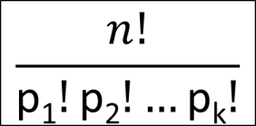
Theorem 3
The number of permutations of n objects where p₁ objects are of one kind, p₂ objects are of second kind… p_{k} objects are of k^{TH} kind is:

Slide 10
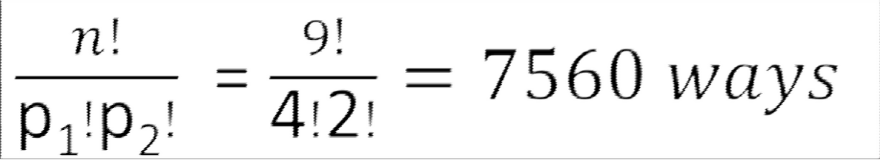
Example
Find number of permutations of word ALLAHABAD.
Here total number of word (n) = 9
Number of repeated A’s (p₁)=4 Number of repeated L’s (p₂)= 2 Rest all letters are different.
Thus applying theorem 3, we have:

Slide 11
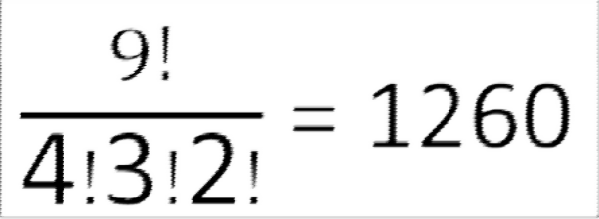
Example
In how many ways can 4 red, 3 yellow and 2 green discs be arranged in a row if the discs of the same color are indistinguishable ?
Sol: Total number of discs are 4 + 3 + 2 = 9. Out of 9 discs, 4 are of the first kind (red), 3 are of the second kind (yellow) and 2 are of the third kind (green).
Thus number of permutation is:

Slide 12
Example
Find the number of arrangements of the letters of the word INDEPENDENCE. In how many of these arrangements,
do the words start with P
do all the vowels always occu r together
do the vowels never occur together
do the words begin with I and end in P?
(v) with I and P interchangeable.

Slide 13
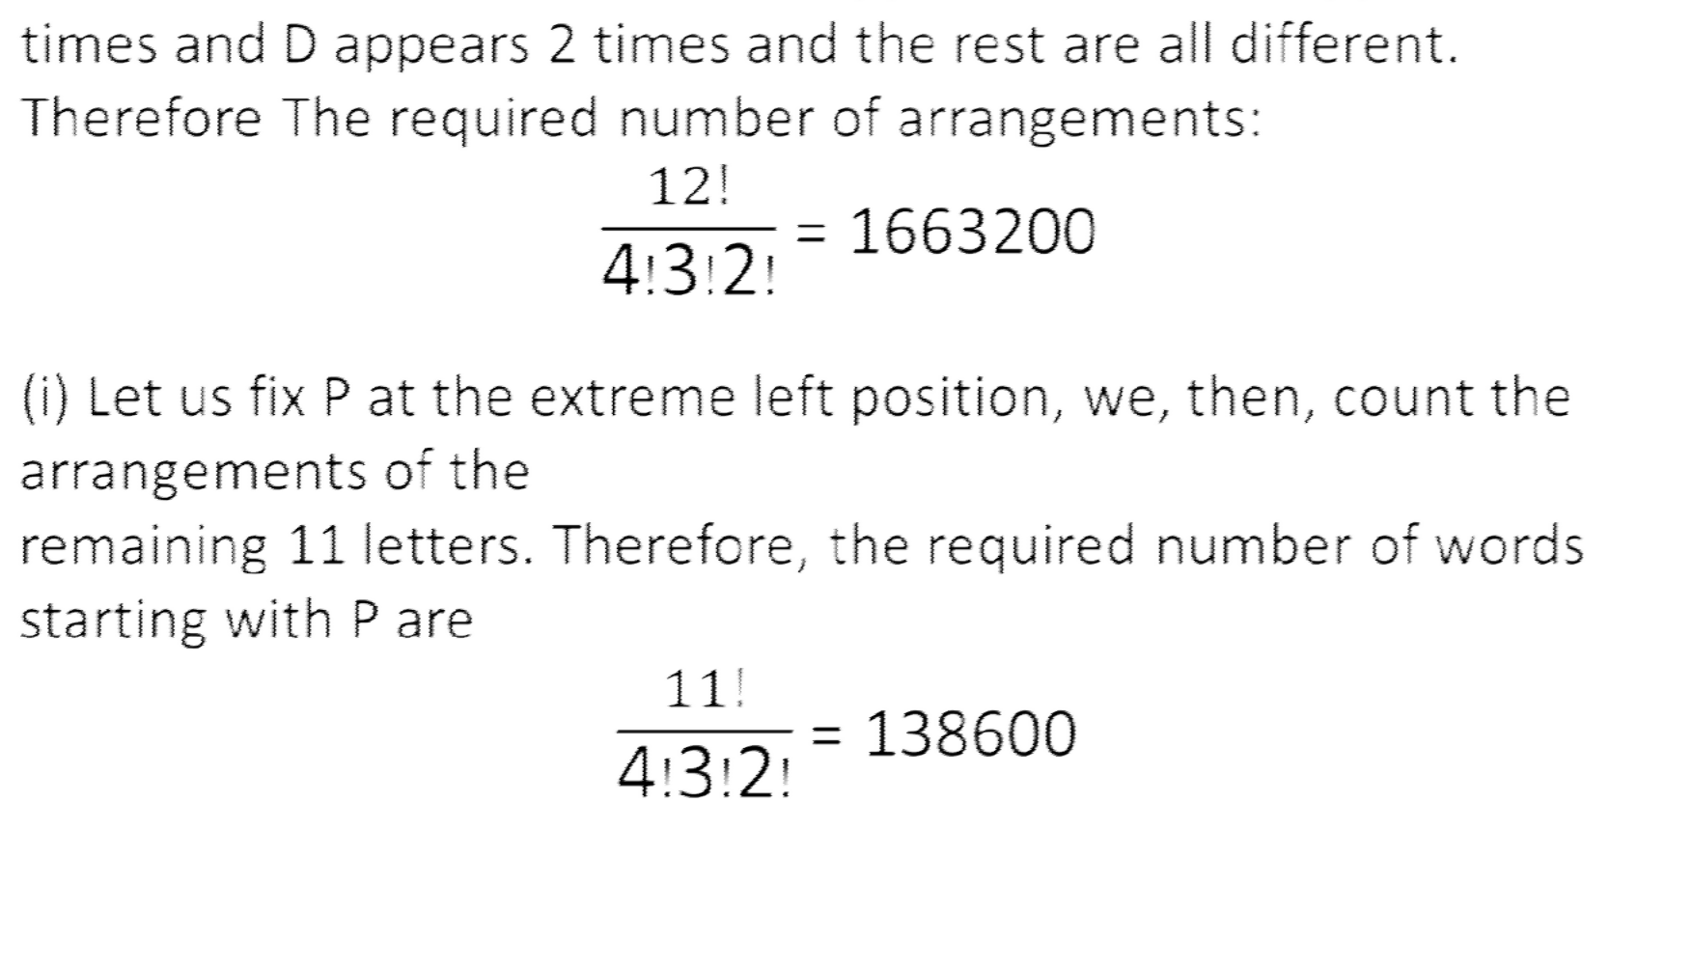
Solution

Slide 14
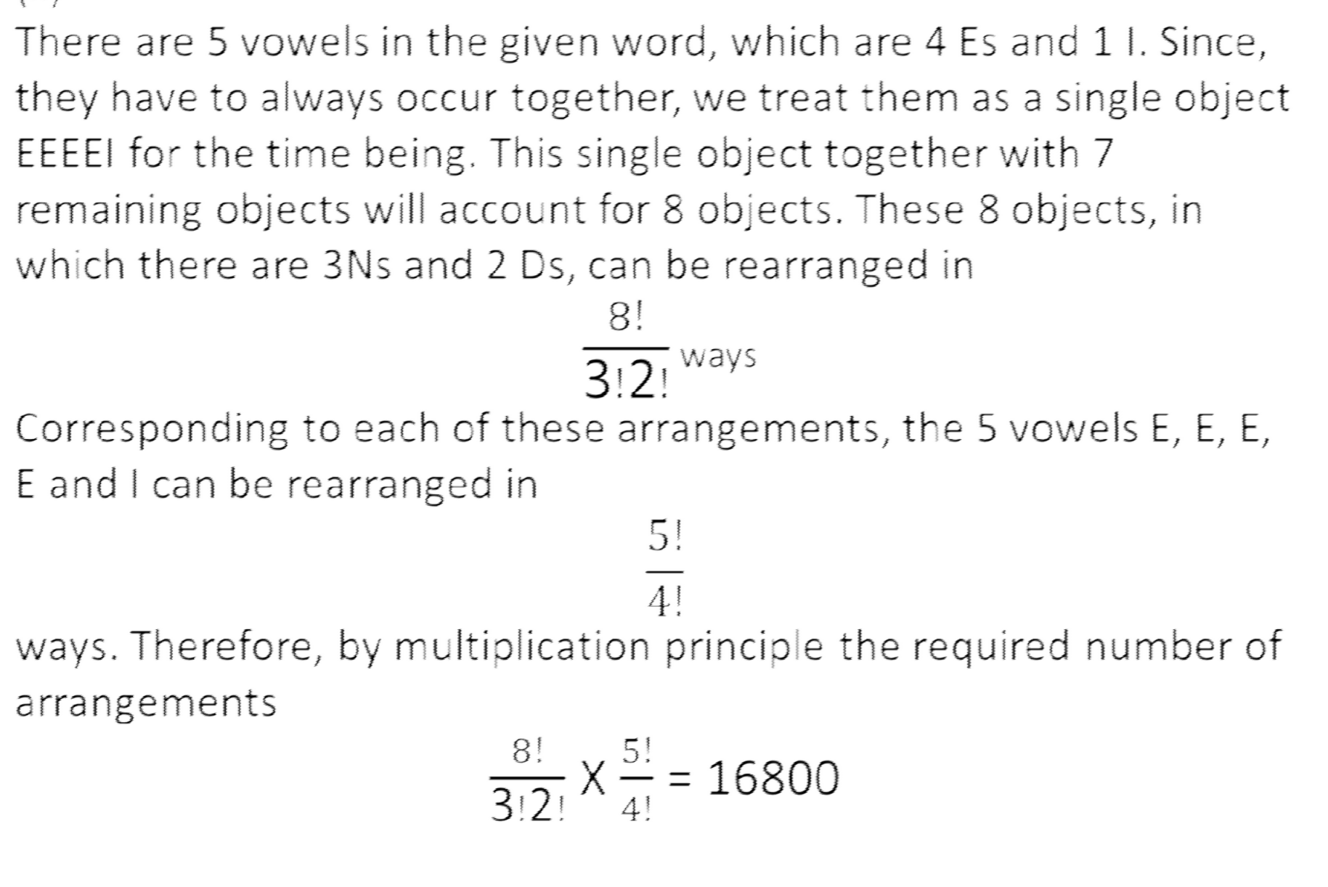

Slide 15
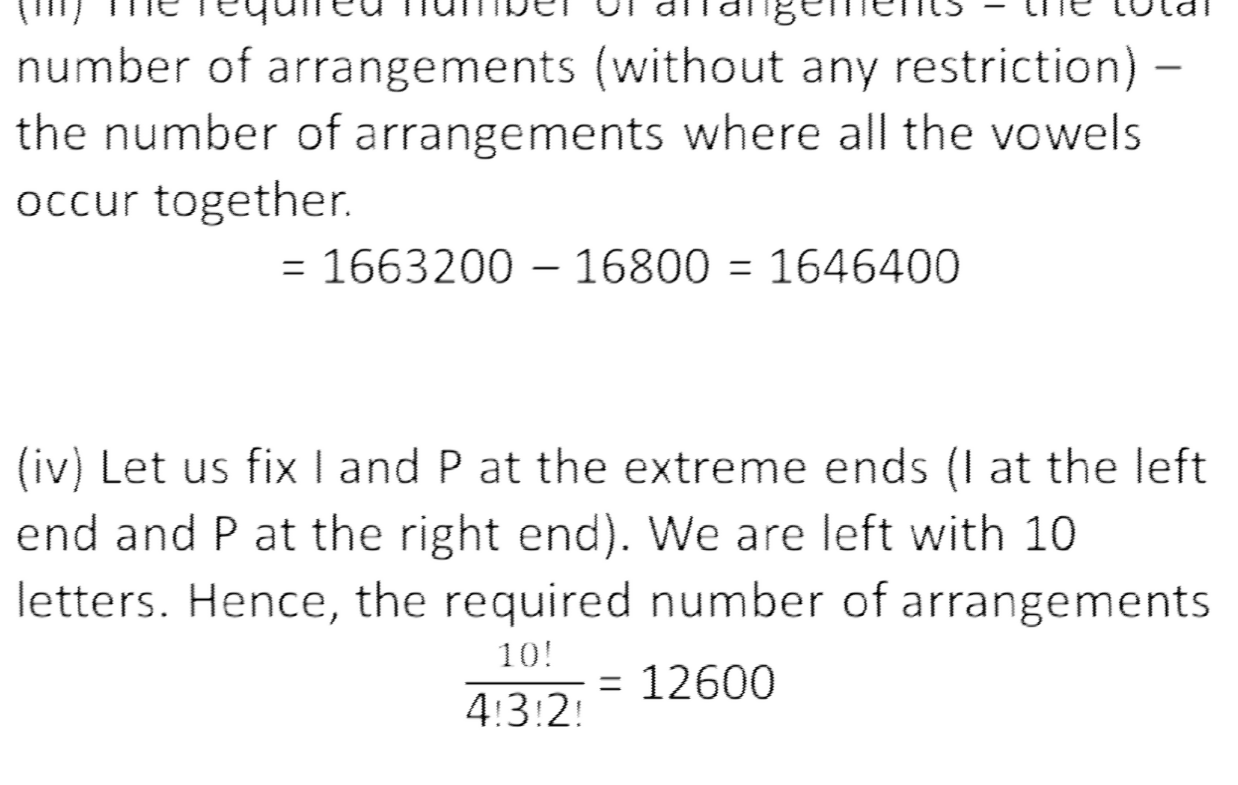

Slide 16
(v) Repeat same parts as part (iv)
As I and P are interchangable they can furthur be arranged in 2! ways.
Thus 12600 X 2! = 25200 ways

Slide 17
Combinations
com·bi·na·tion
The act or an instance of combining; the process of being combined.
Definition:
A Combination is a selection of some or all of a number of
different objects. It is an un-ordered collection of unique sizes.
Note:
Whenever we deal with combinations, order is not important.

Slide 18
Combinations
Suppose we have 3 teams . A,B and C. By permutation we have
³P₂ = 6.
But team AB and BA will be the same. Similarly BC and CB will be the same. And AC and CA are same.
Thus actual teams = 3.
This is where we use combinations.

Slide 19
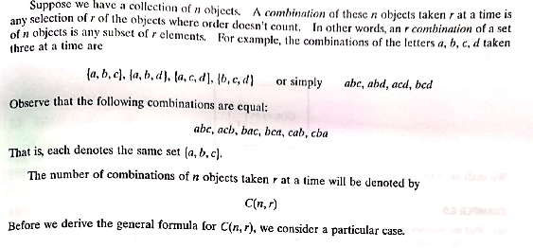

Slide 20
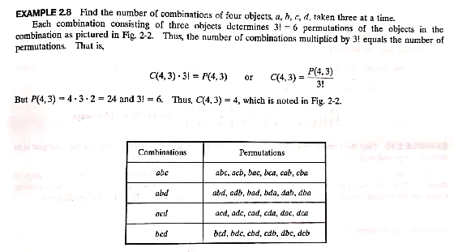

Slide 21


Slide 22
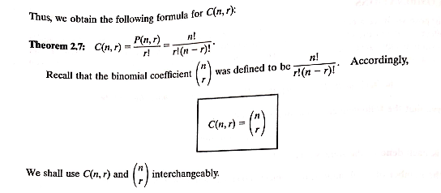

Slide 23
Formula
n!
^{n}c_{r} =
r! (n-r)!

Slide 24
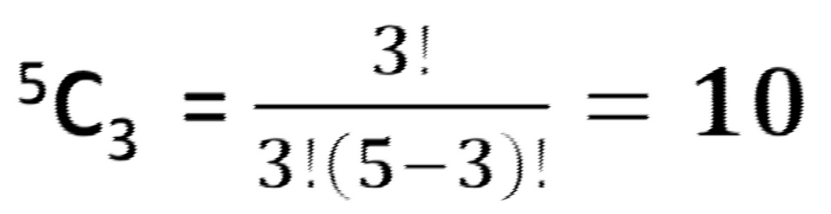
Example
A committee of 3 persons is to be constituted from a group of 2 men and 3 women. In how many ways can this be done?
Here, order does not matter. Therefore, we need to count combinations. There will be as many committees as there are combinations of 5 different persons taken 3 at a time. Hence, the required number of ways =

Slide 25
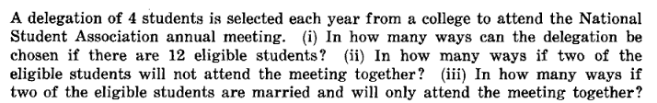

Slide 26
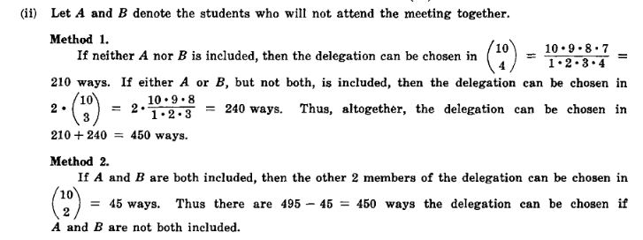

Slide 27


Slide 28
Determining a question is of Permutation or Combination
If the problem says " find in how many ways can they be
Arranged / Lined Up, made, ...."
then it is a problem on Permutations.
If the problem says " find in how many ways can it/they be
Selected / Chosen / Drawn / Taken/ grouped......"
then, it is a problem on Combinations.

Slide 29
A student is to answer 8 out of 10 questions on an exam. (i) How many choices has he? (ii) How many if he must answer the first 3 questions? (iii) How many if he must answer at least 4 of the first 5questions?

Slide 30
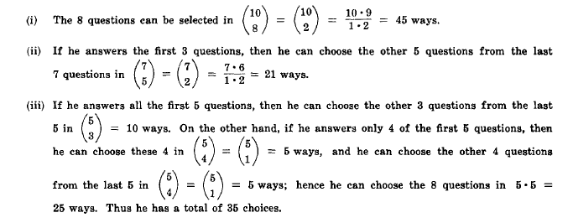

Slide 31
In how many ways can 7 toys be divided among 3 children if the youngest gets 3 toys and each of the others gets 2?

